Slide 1


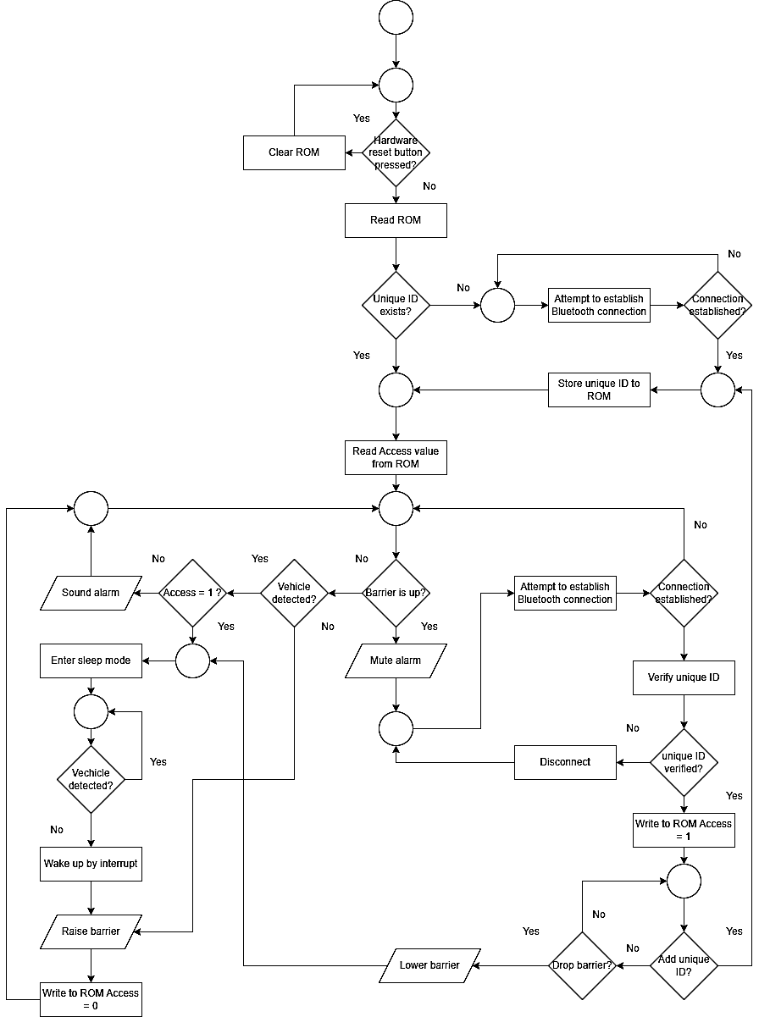
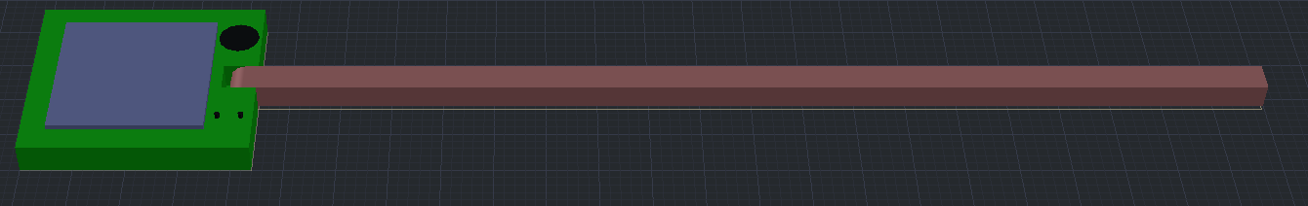
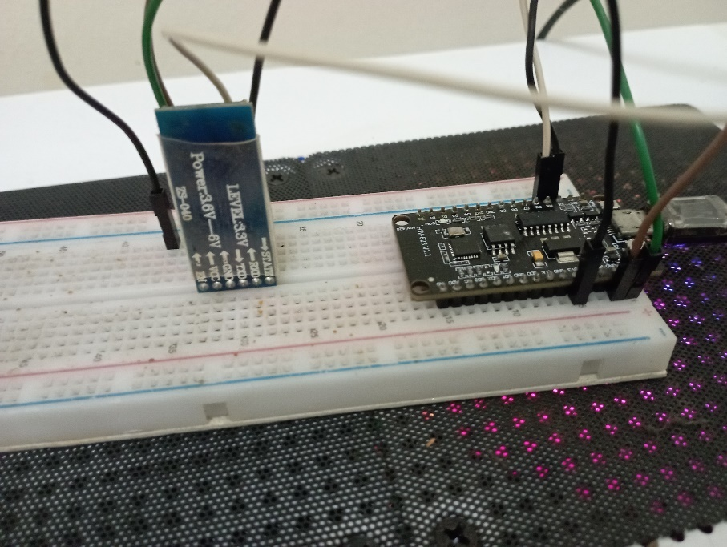
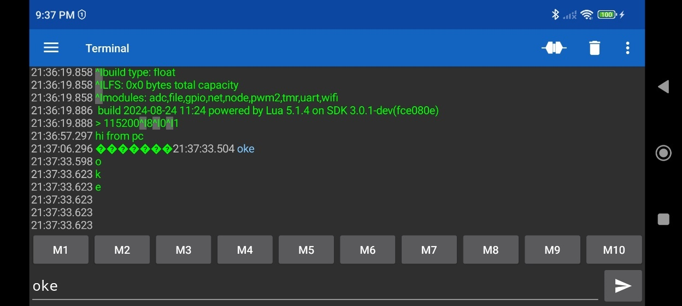
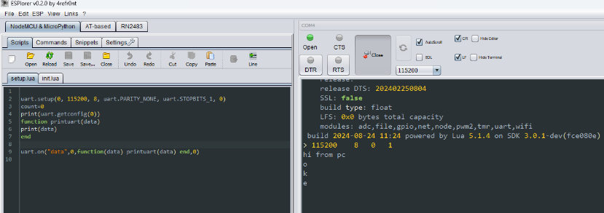
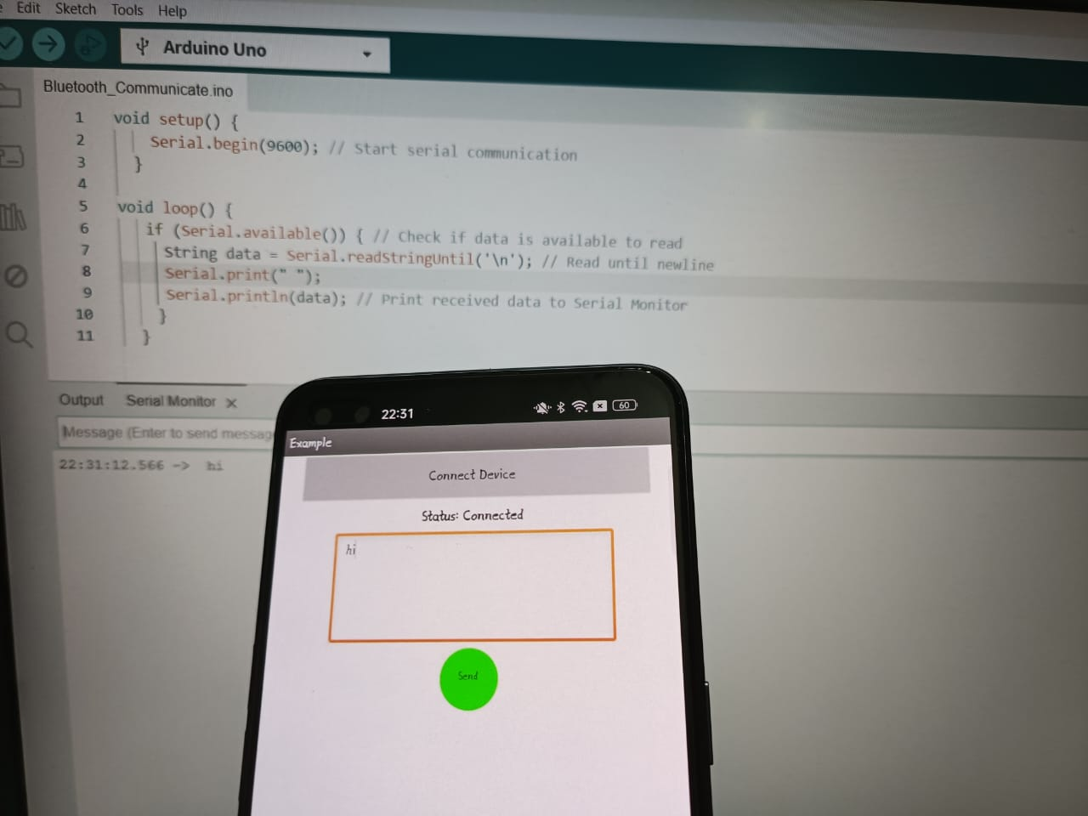

PORTABLE PARKING RESERVATION WITH IOT CONTROL
Introduction
This project aims to develop the portable parking reservation system with IoT control. As cities grow larger and accommodate a bigger population, many find their personal parking spots and even OKU parking spots stolen by unauthorized strangers. As such, this project proposes to make a device which is small and able to deter the stealing of parking spots. Furthermore, since the device is aimed to be deployed outdoors, a solar panel will be incorporated into the device such that it is self-sustaining. This project also aim to develop single user control trough IoT for many parking especially OKU parking which will be proposed to MPIP.
objective
To design a portable parking reservation with IoT control.
To design the system within the power constraint of the solar panel.
Design a singles system control multiple barrier using IoT
Flowchart
Problem statement
Many drivers will occupy reserved parking spots unauthorized
There are seldom also drivers who did not notice that they have parked on a reserved parking spot unauthorized.
It will cause inconvenience for the people who needs these reserved parking spots like the OKU and the others who should have access to these reserved parking spots.
Compact design occupies minimal space.
Barrier can be easily pushed down without causing damage to vehicles.
Solar panel remains unblocked when the barrier is in the upright position.
Simple and cost-effective design.
Result
-Börklü, H. R., Kalyon, S. A. (2017, December 27). A Design Study of an Innovative Barrier System for Personal Parking Lots.
-New Straits Times. (2023, December 20). #NSTviral: Couple faces backlash for misusing disabled parking [WATCH].
-Santos, R., Santos, S. (2023, September 29). Getting Started with the ESP32 Development Board.
Supervisor : Dr. Vasanthan A/L Maruthapillai
Inventor Name : Khoh Chun Poh & Joseph Lee Jian Fong

