Slide 1

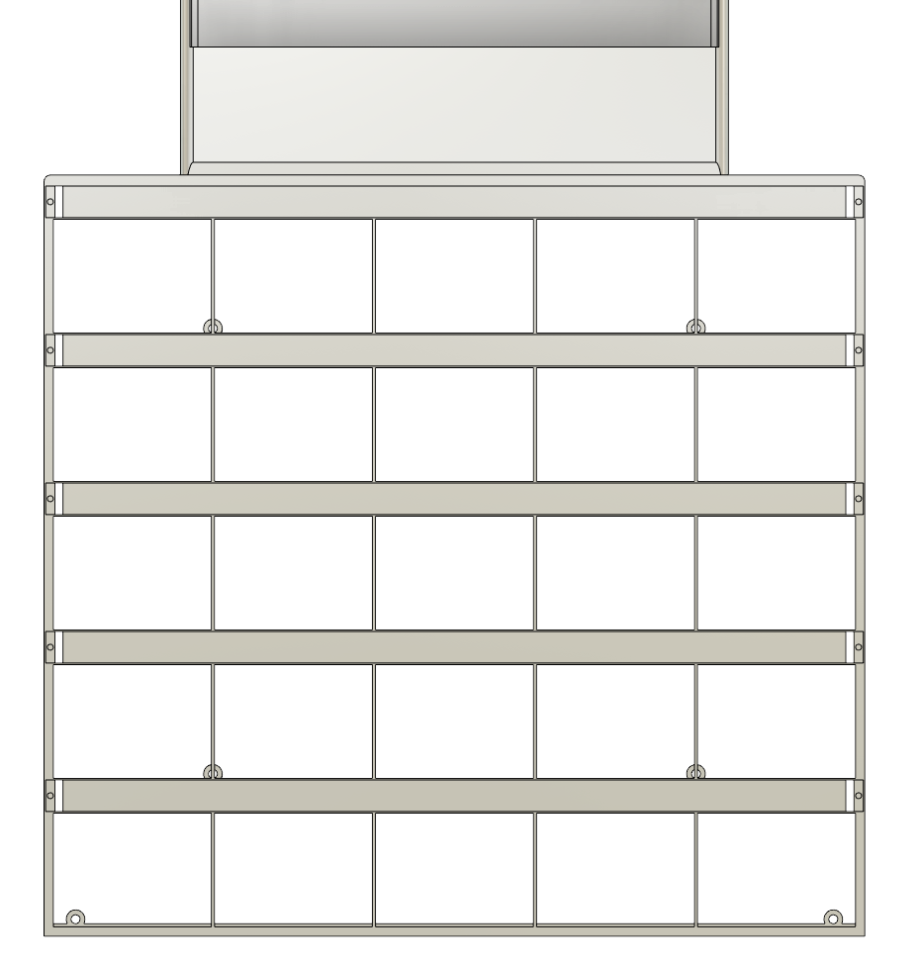




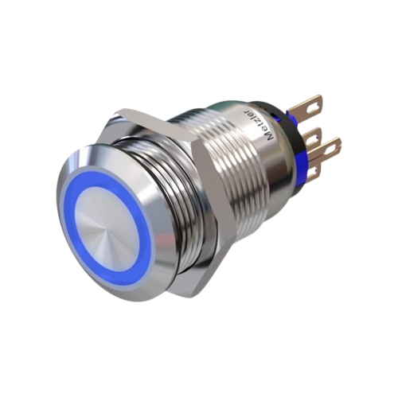
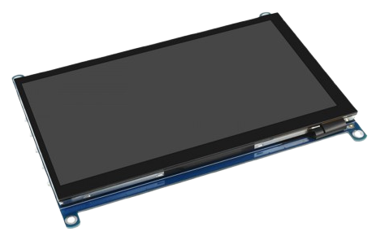
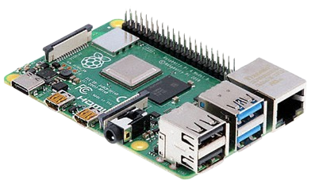
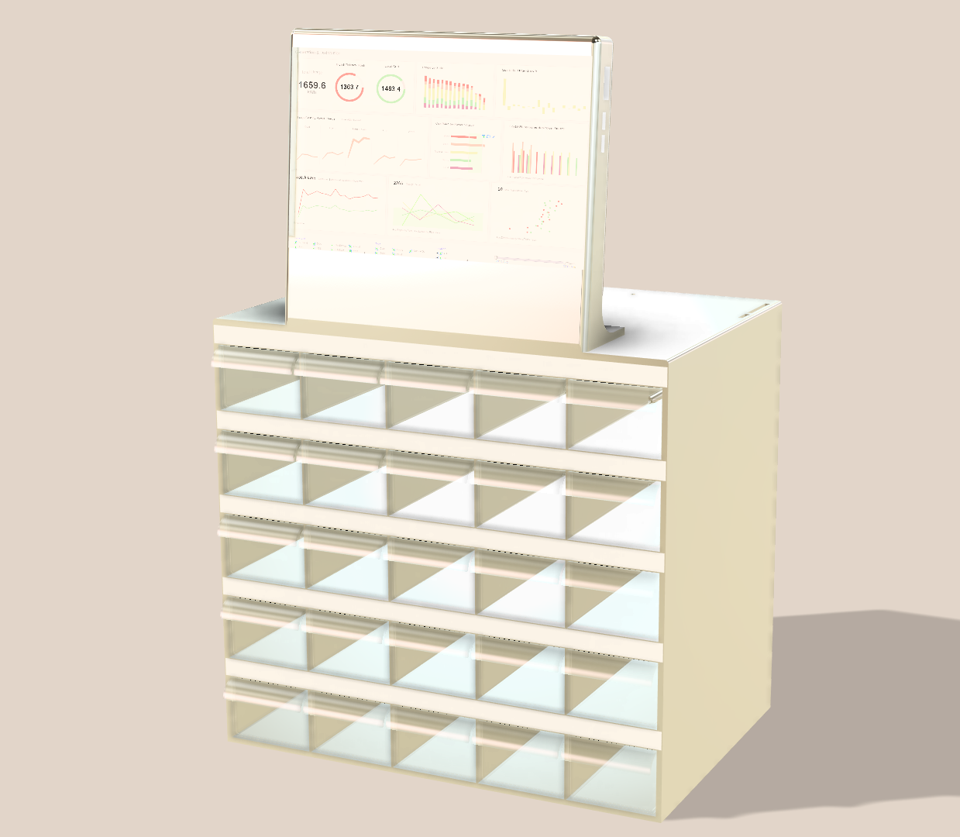
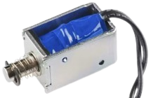
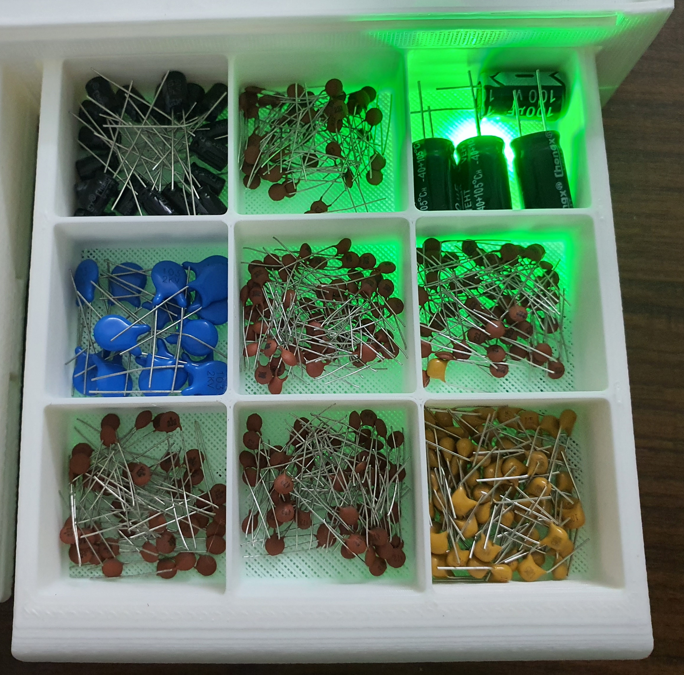
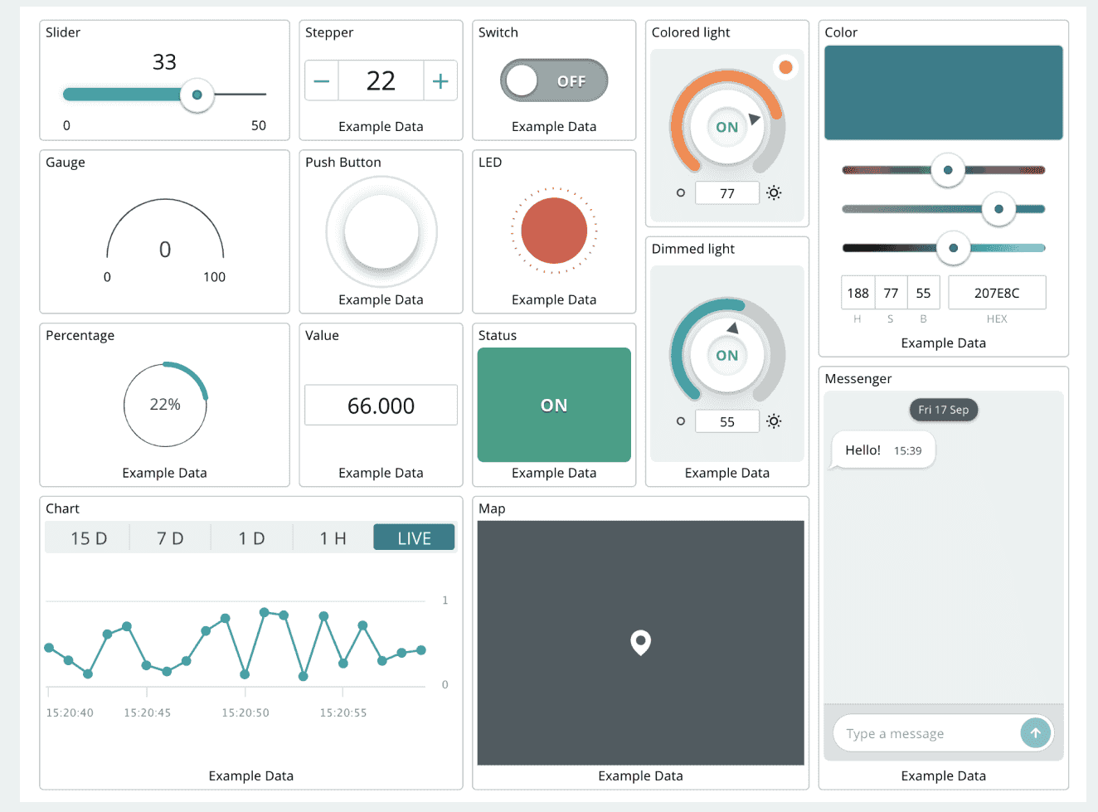

Electronizer V2 – Smart IOT Electronics Organizer
1. Introduction
5. Technologies
Imagine having hundreds or thousands of component categories and needing only a few specific ones for a project. Searching through a standard organizer drawer by drawer becomes a time-consuming process, with the possibility of missing or never finding the required parts. By integrating the smart electronics organizer system, users can manually check the stock of components or utilize the IoT cloud to monitor inventory in real time, from anywhere and at any time! This solution streamlines component management, saving time and reducing the risk of errors.
Python (General)
NodeJS (Website)
MySQL (Database)
PySide6 (UI)
PyQt6 (UI)
6. Potential Market
2. Problem Statements
Lab
Warehouse
Workshop
Sorting Station
Electronics Retailers
Home
Pharmacy
Repair and Maintenance Services
Small-Scale Manufacturers
Manually searching through standard organizers to find specific electronic components is inefficient and time-intensive, especially when managing a large number of categories.
The manual process of locating parts increases the chances of missing or misidentifying components, leading to potential delays in project completion.
Traditional organizers do not offer real-time visibility into stock levels, making it difficult to know if a component is available without physically checking the organizer, limiting convenience and flexibility.
7. Impact on Society
3. Objectives
Increased efficiency for hobbyists and professionals
Supports Digital Transformation
Reduces Wastage and Over-Stocking
Increased Accessibility and Convenience
Pormosion of Industry 4.0
To design a system that streamlines component search
To integrate IoT for real-time inventory management
To minimize human error by clearly indicating component availability and location.
4. Methodology
Start
Features
Touch Screen
IOT
Auto Seach
LED
8. SDGs
1 2 3 4 5
Input name/ types/ values
10 9 8 7 6
Text Analysis
11 12 13 14 15
Searching for exact or similar components
20 19 18 17 16
21 22 23 24 25
Displays status of findings
Records request in Database
Buttons
7” IPS TFT Display
No
Found?
Yes
Push the container
Microprocessor
Lights the container
End
Solenoid
LED Strips
Dashboard
NG KHAI LE | LEONG KAH MENG | CHAN BUN SENG |
NURAMIRAH BINTI ROSMAN | DR. HUI SENG KHEONG |
IR. DR. VASANTHAN MARUTHAPILLAI | DR. NUR DALILAH
COLLABORATION & PARTNERSHIP
Leong Kah Meng
kmleong@sc.edu.my
Science and Engineering Category

