Slide 1


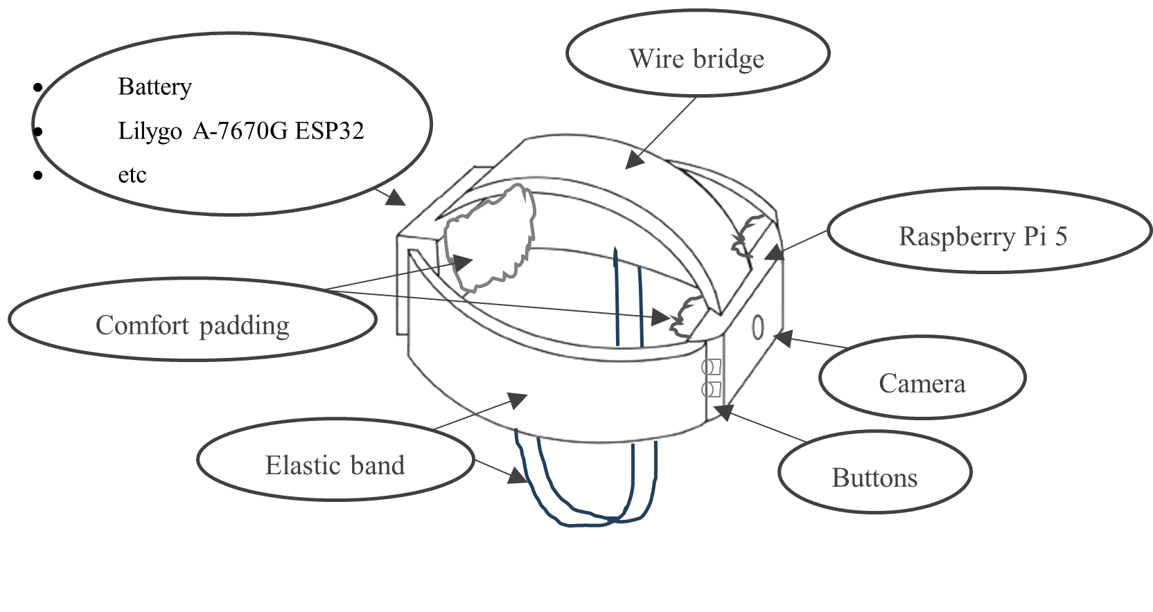
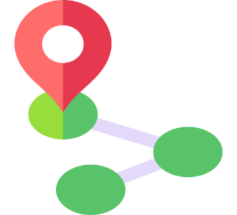

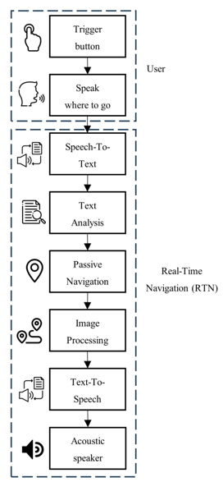




THE OBSTASENSE – AN INTELLIGENT OBSTACLE AVOIDANCE ELECTRONIC TRAVEL AID FOR VISUALLY IMPAIRED INDIVIDUALS
Abstract
ObstaSense is a wearable obstacle avoidance and navigation aid for visually impaired individuals, designed to work in both daylight and low-light conditions. Using the TensorFlow SSD MobileNet v2 model on a Raspberry Pi 5, it detects obstacles like people, cars, and bicycles, and provides real-time alerts. The device features Real-Time Navigation (RTN) with voice assistance, guiding users to key destinations via OpenRoute Service’s API, eliminating the need for exact location names. Integrated with 4G LTE for continuous connectivity, it ensures smooth, real-time navigation. ObstaSense offers an affordable solution, aligning with SDGs 3 and 10 to promote well-being and reduce inequality.
ObstaSense Features
Design Structure
Obstacle Avoidance
Real-Time Navigation (RTN)
  Passive Navigation
  Voice Assistant
  Image Processing
4G LTE Communications
Problem Statement
Global Impact: 2.2 billion people globally have visual impairment (WHO, 2023).
Local Impact: 4 million people with VI in Malaysia (IAPB, 2020).
Navigation Challenges: Difficulty navigating unfamiliar surroundings and insecurity without tactile pedestrian facilities.
Limitations of Guide Dogs: Limited availability and ineffective communication.
ETA Limitations: Insufficient obstacle detection in many existing devices.
Weight is well-distributed
Fit at any radius of the head
Not easily fell off
Comfortable
Horizontal and Vertical elastic band
Comfort padding
Attractive appearance
Methodology
Tensorflow 2
Search/ Prepare image
need to improve / not in COCO dataset
Labelling the images
Train the images
Evaluation and Fine-Tuning
Objectives
To design a wearable obstacle avoidance and assistive navigation aid for visually impaired individuals.
To integrate a voice assistant to enhance navigation experience.
To test the ObstaSense.
Real-Time Navigation (RTN)
User
RTN
Passive Navigation
Image Processing
Impact of society
Trigger Button
ObstaSense enhances independence and safety for visually impaired individuals by providing real-time obstacle detection, reducing accidents and reliance on others. Its affordability and accessibility promote inclusivity, making assistive technology available to a wider population, especially in low-income communities.
Text Analysis
Text To-Speech
Speak Where To Go
Speech To-Text
Acoustic Speaker
Abidi, M. H., Siddiquee, A. N., Alkhalefah, H., & Srivastava, V. (2024). A comprehensive review of navigation systems for visually impaired individuals. Heliyon.
Andrea, R., Ikhsan, N., & Sudirman, Z. (2022). Face Recognition Using Histogram of Oriented Gradients with TensorFlow in Surveillance Camera on Raspberry Pi. International Journal of Information Engineering & Electronic Business, 14(1).
Supervisor : Ts. Dr. Kang Eng Siew
Co-Supervisor : Leong Kah Meng
Ng Khai Le
Inventor Name :
Ngeu Chee Hau @ Yeo Chee Hau

