Slide 1
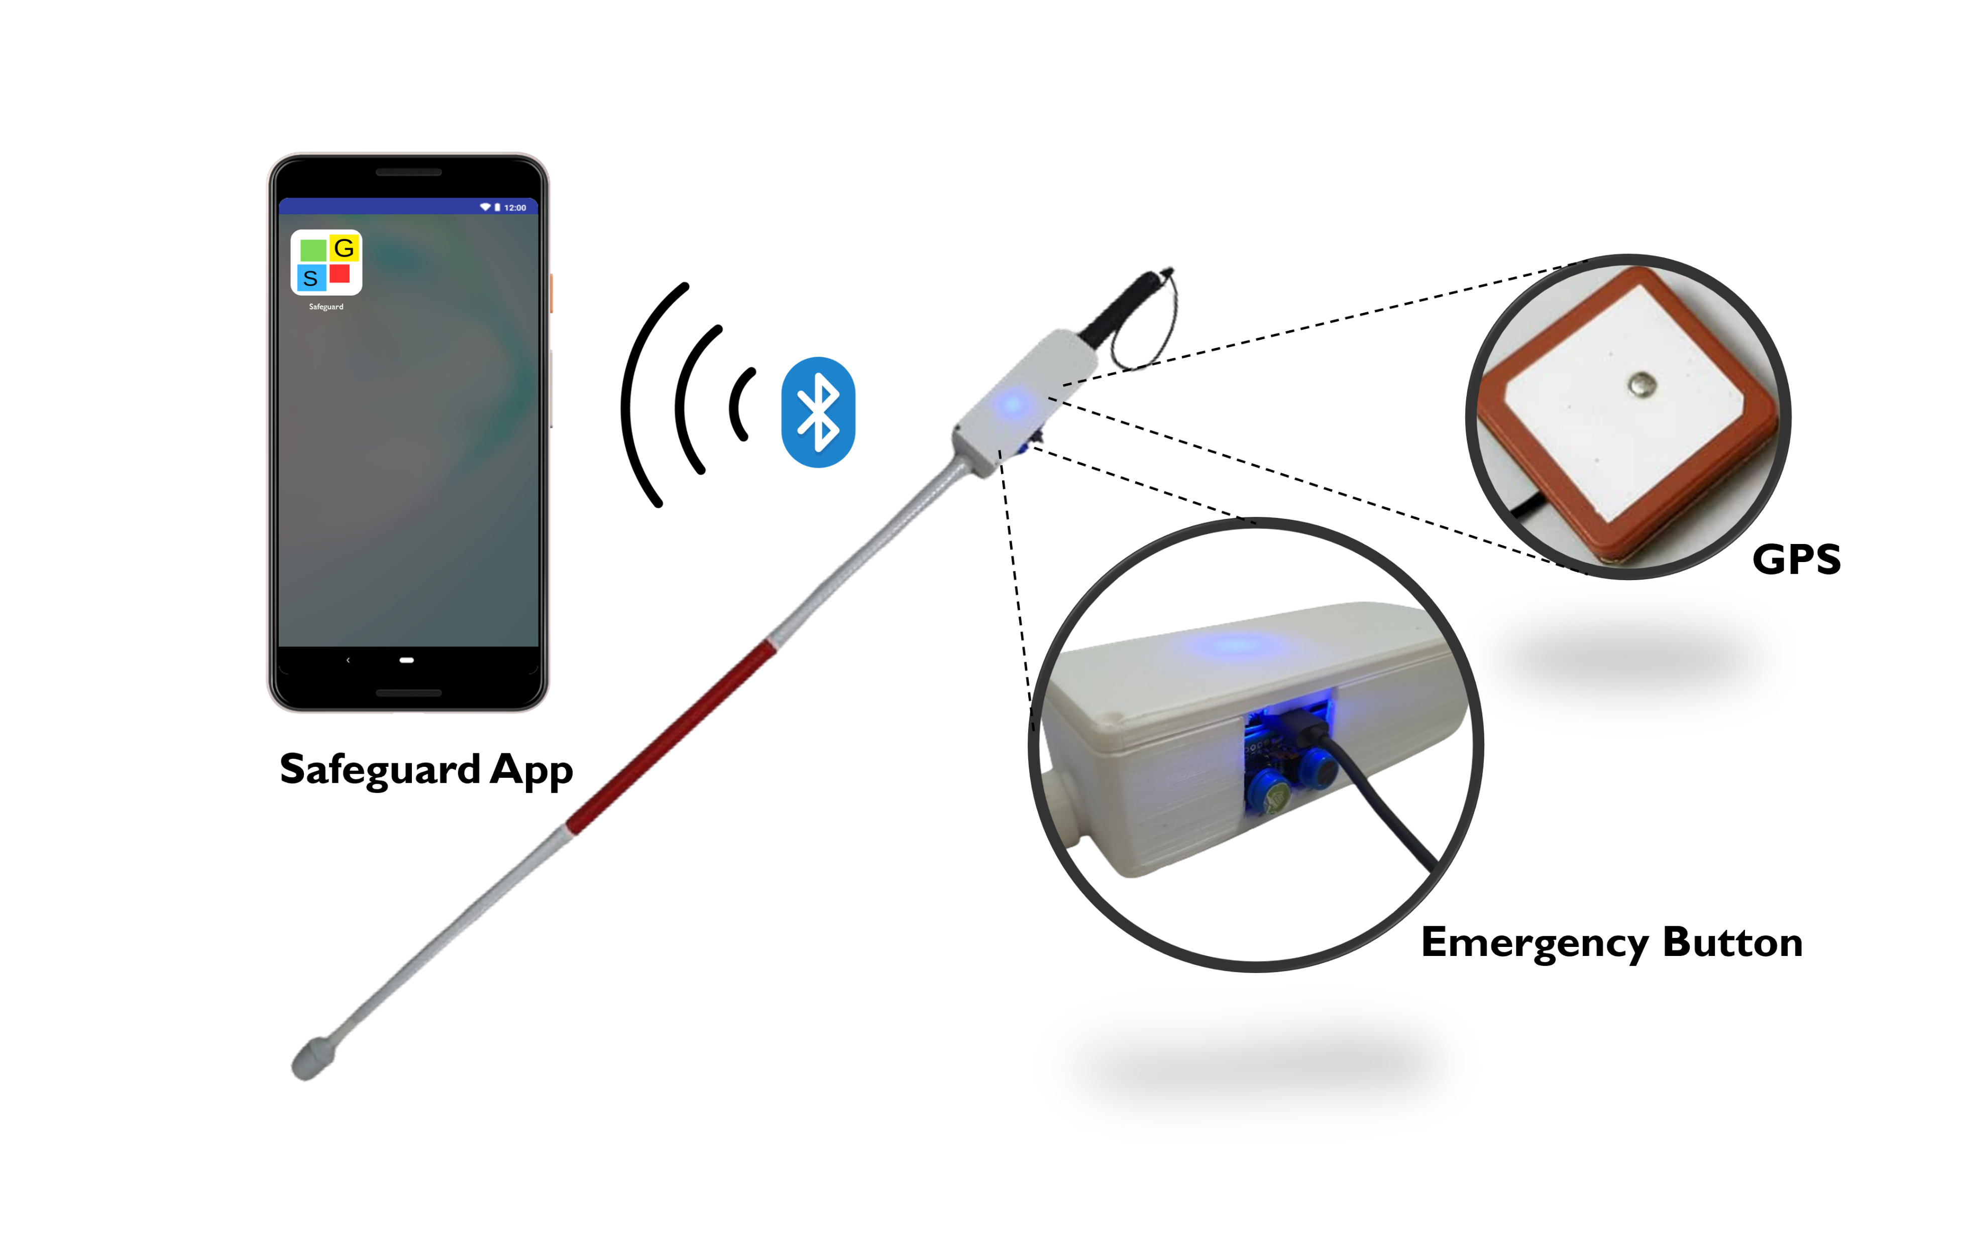
Smart Safeguard Cane
1
INTRODUCTION
AUTO EMERGENCY MODE
VISUAL
PREFERENCES
Blind individuals cannot move around freely due to the inability to see obstacles, navigate spaces, recognize visual cues, and the risk of accidents or injury in unfamiliar environments.
The Safeguard Cane is consisting of hardware (Multifunction Cane) and also software (Safeguard App – navigation)
Safeguard Cane is for fully blind, low vision, and visually impaired people, but it also suits the elderly, patients in Malaysia.
NAVIGATION
FEATURES
2
OBJECTIVES
To design a user-friendly Safeguard Cane with a navigation app for low vision and blind people, with a fall detection auto-emergency notification system in a cane.
OBSTACLE DETECTION
TEXT TO SPEECH
GESTURE DETECTION
3
MAIN IDEAS
Featuring an innovative early fall detection system, the Safeguard Cane boasts emergency functionality while also supporting advanced navigation capabilities.
Its unique selling point is the built-in early fall detector with IMU sensors constantly tracking user movements. If the cane detects a user falling, it will send an SMS notification to a designated contact person.
The Safeguard App is an app that consist gesture detection, text-to-speech and high contrast test options available for users with visual impairments.
The smart mobile app facilitates home finding and navigation to essential locations like restrooms and bus stops with one-click functionality.
6
POTENTIAL MARKET
Visually Impaired Individuals
Nursing House
Travel Agency
Hospital
Home Users
7
IMPACT TO SOCIETY
4
Reducing the risk of injury and ensuring timely assistance.
Reduce inequalities (SDG 10)
Increase visually impaired individuals' confidence level and sense of security
Support independence for users with visual impairments or mobility challenges.
TECHNICAL
FLOW CHART
TECHNICAL
FLOW CHART
5
SYSTEM
ARCHITECTURE
TEAM MEMBERS:
Collaboration and
Partnership
Leong Kah Meng | Ng Khai Le | Ngeu Chee Hau@Yeo Chee Hau|
Tung Khai Yen | Siew Zi Yang | Ts. Dr. Kang Eng Siew | Chan Bun Seng
Leong Kah Meng
kmleong@sc.edu.my
Science and Engineering Category

